Slide 1

Project 2 - NBA Playoffs
Himmat Jagdev, Sapana Hingrajia, Jake McGraw, Joanna Rios

Slide 2
Executive Summary
Our project aims to develop a predictive model to determine the likelihood of NBA teams making the playoffs. By leveraging a comprehensive set of statistical variables, we can gain deeper insights into team performance and enhance the accuracy of our predictions. The key variables in our analysis include Wins & Losses, Average Team Age, Pythagorean Wins/Losses, Net Rating, Strength of Schedule, Margin of Victory, Simple Rating System (SRS), and True Shooting Percentage (TS%).
Enhanced Predictive Accuracy: By incorporating multiple dimensions of team performance, our model surpasses traditional win-loss records, providing a more holistic and accurate prediction of playoff probabilities.
Notes:
Talk about how our intention was to predict championships however based it being beyond our scope and being in a time crunch

Slide 3
Approach & Methods
We aggregate and analyze historical data for these variables across multiple seasons to train our predictive model. The model utilizes machine learning techniques to identify patterns and correlations that significantly influence playoff outcomes. By integrating these variables, we achieve a nuanced understanding of team dynamics, enabling us to forecast playoff probabilities with greater precision.

Slide 4
Advanced Statistics
Wins & Losses
Age - Average age of entire team as of February 1st of the season
Pythagorean Wins/Losses - Expected wins/losses based on points scored and allowed
Net Rating - An estimate of point differential per 100 possessions
Strength of Schedule - A rating of strength of schedule. The rating is denominated in points above/below average, where zero is average
Margin of Victory - How many points does a team win by on average
Simple Rating System - A Team rating that takes into account average point differential and strength of schedule. The rating is denominated in points above/below average, where zero is average
True Shooting Percentage - A measure of shooting efficiency that takes into account 2-point field goals, 3-point field goals, and free throws
Notes:
Wins & Losses
Importance: Basic measure of team success.
Analysis: Directly correlates with playoff qualification and seeding.
Impact: Teams with high win counts generally have better playoff and championship probabilities.
Age
Importance: Reflects the experience and potential durability of a team.
Analysis: Younger teams may have more energy but less experience; older teams may be more experienced but prone to injuries.
Impact: Balancing youth and experience is key for sustained success in playoffs and championships.
Pythagorean Wins/Losses
Importance: Expected performance based on points scored and allowed.
Analysis: Provides a more accurate measure of a team's true strength compared to actual win-loss records.
Impact: Helps predict future performance and playoff potential by highlighting over performing or underperforming teams.
Net Rating
Importance: Point differential per 100 possessions.
Analysis: High net rating indicates strong overall performance on both offense and defense.
Impact: Crucial for evaluating team efficiency and predicting success in tightly contested playoff games.
Strength of Schedule
Importance: Measures the difficulty of a team’s schedule.
Analysis: Teams with tougher schedules might have fewer wins but can be stronger than their record suggests.
Impact: Important for contextualizing win-loss records and assessing playoff readiness.
Margin of Victory
Importance: Average points by which a team wins games.
Analysis: Higher margins suggest dominant performances and consistent play.
Impact: Teams with larger victory margins are often more likely to succeed in the playoffs and contend for championships.
Simple Rating System (SRS)
Importance: Combines average point differential and strength of schedule.
Analysis: Provides a holistic view of team strength.
Impact: Effective for comparing teams across different schedules and predicting playoff outcomes.
True Shooting Percentage (TS%)
Importance: Measures shooting efficiency considering all types of shots.
Analysis: High TS% indicates effective scoring, crucial for playoff success.
Impact: Teams with high TS% are often more efficient offensively, giving them an edge in high-stakes playoff situations.
Conclusion
Comprehensive Analysis: Using these variables together provides a robust framework for evaluating past and future NBA championship and playoff probabilities.
Strategic Insights: Identifies strengths and weaknesses, informs coaching strategies, and predicts team performance under playoff pressure.
Future Projections: Enhances the accuracy of predicting playoff success and championship potential by accounting for the nuanced interplay of these statistical factors.

Slide 5
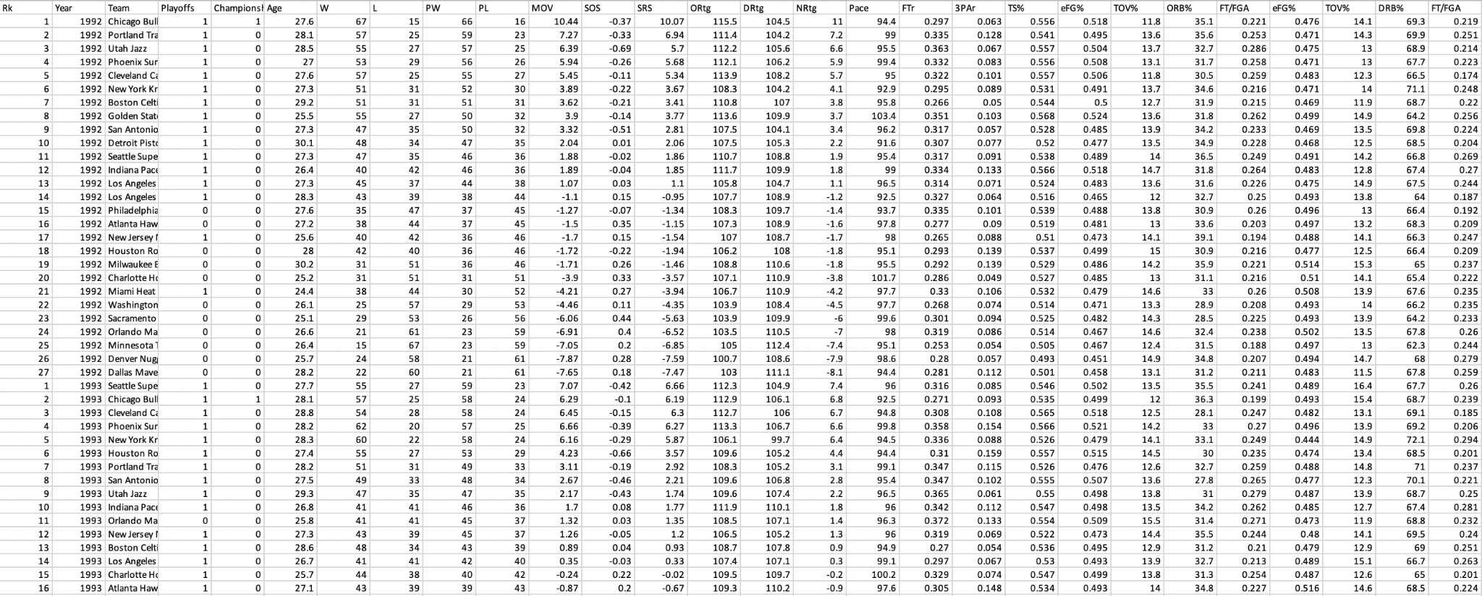
Example Of Our Data

Slide 6
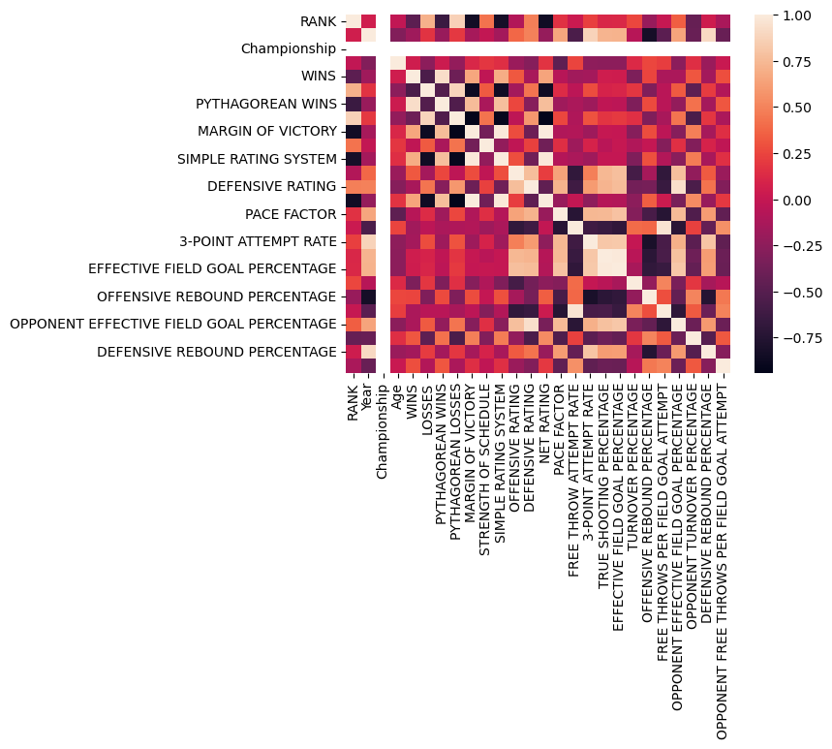
Exploring the Data
A heat map based on the correlation table was created to identify the most important variables before starting the prediction.

Slide 7
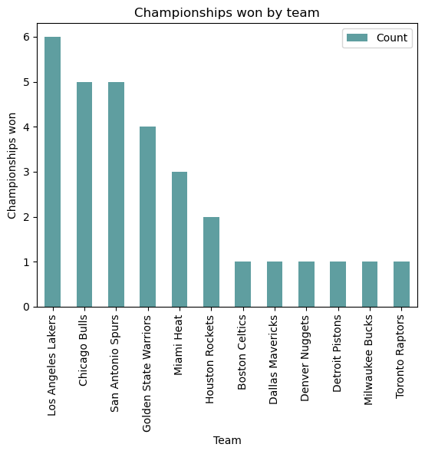
Analysis
To make accurate predictions, it's essential to identify which teams have consistently performed well over the years.

Slide 8
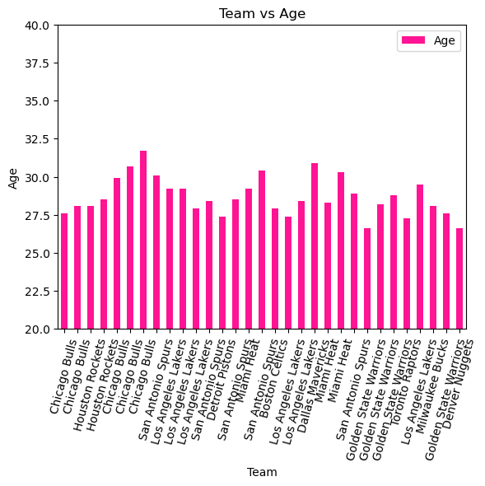
Is Age an important factor?
Minimum age 26.6
Maximum age is 31.7

Slide 9
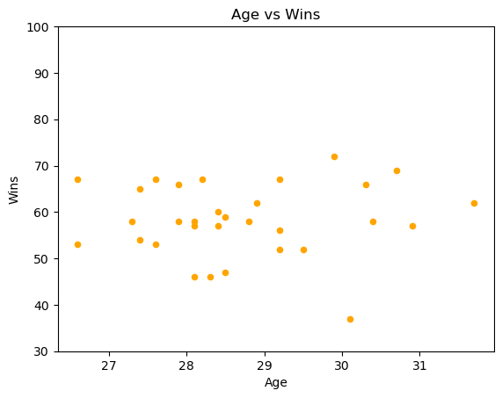
No explicit correlation was found between age and wins

Slide 10
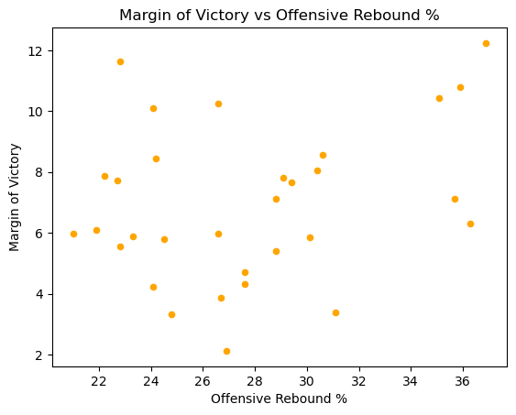
While it might not exist a clear or linear tendency between Margin of victories and Offensive rebound.
Data suggest it matters in certain cases.

Slide 11
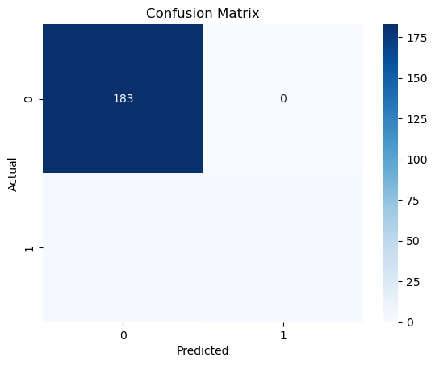
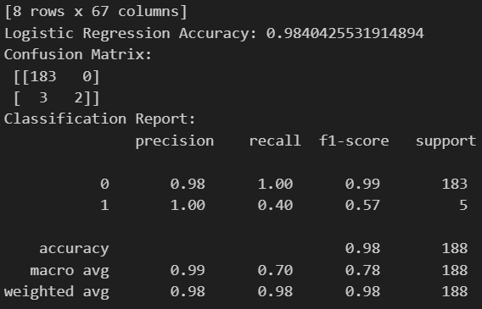
Logistic Regression (Championship)
98.4% Accuracy
Notes:
-The logistic regression model achieves an accuracy of 98.40%, with a confusion matrix showing 183 true negatives (no championship) and 2 true positives (championship). However, the report indicates challenges in classifying the positive class (championship), with a lower recall and F1-score due to only 2 true positives out of 5 total positives.
-Given this information, it's important to note that the class imbalance in the target variable (championship) might affect the model's performance, especially in terms of correctly identifying instances of championship wins. So, we decided use Playoffs as the Target Variable for Logistic Regression and Random Forest Classifier.

Slide 12
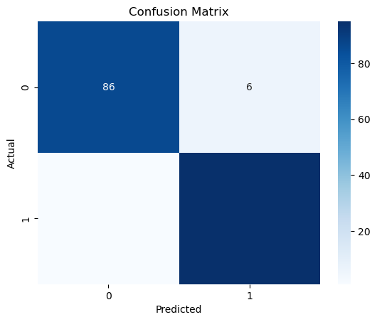
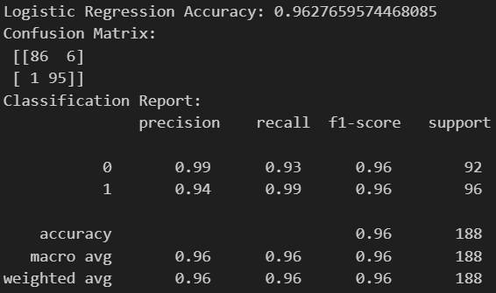
Logistic Regression (Playoffs)
96.28% Accuracy
Notes:
-The logistic regression model achieves an accuracy of approximately 96.28%. The confusion matrix shows that out of 188 samples, 86 were correctly predicted as not making the playoffs (true negatives), 95 were correctly predicted as making the playoffs (true positives), 6 were incorrectly predicted as making the playoffs when they didn't (false positives), and 1 was incorrectly predicted as not making the playoffs when it did (false negative). The model achieved high precision, recall, and F1-score for both classes, indicating good performance.
-Overall, the logistic regression model appears to perform well on the given dataset for predicting playoff appearances based on the selected features.

Slide 13
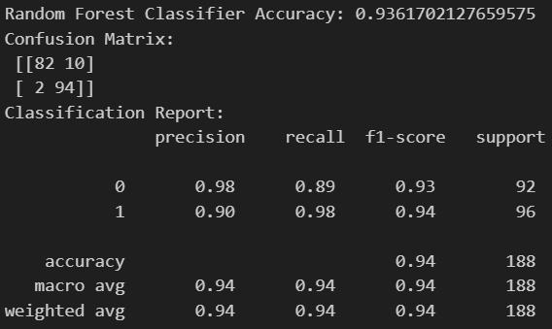
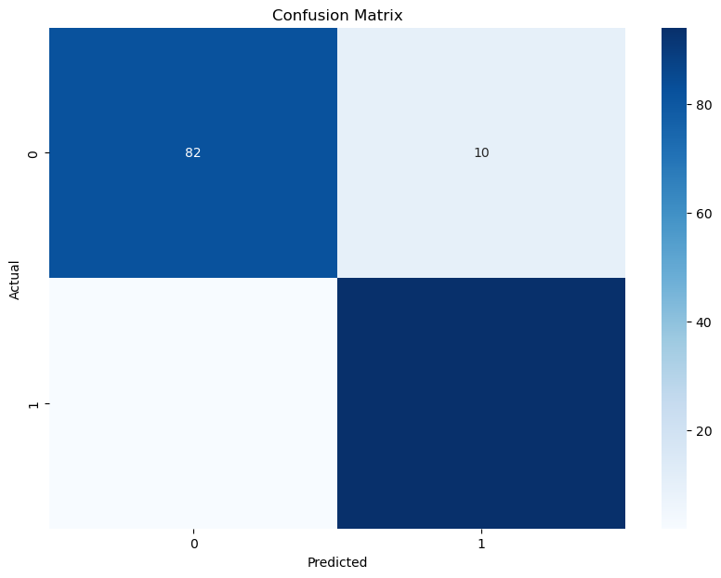
Random Forest Classifier (Playoffs)
93.62% Accuracy
Notes:
-The Random Forest Classifier model achieves an accuracy of approximately 93.62%. Both models have similar confusion matrices, but the Logistic Regression model has fewer false positives (6) compared to the Random Forest Classifier (10).
-Both models perform well, with the Logistic Regression model slightly outperforming the Random Forest Classifier in terms of accuracy and precision for predicting both classes. However, the Random Forest Classifier exhibits slightly higher recall for class 1 (making playoffs), indicating its ability to better identify instances of this class.

Slide 14
Results
Our project demonstrates that a sophisticated analysis incorporating multiple statistical variables offers a powerful tool for predicting NBA playoff participation
The logistic regression model (Championship) achieves an accuracy of 98.40% on the test set
The logistic regression model (Playoffs) achieves an accuracy of approximately 96.28% on the test set
The Random Forest Classifier model (Playoffs) achieves an accuracy of approximately 93.62% on the test set

Slide 15
Discussion
By understanding and applying these insights, stakeholders can better navigate the complexities of team performance and enhance their strategic planning for future seasons.
Notes:
NBA statistics involve human factors, making them far more nuanced compared to stock projections. Unlike stocks, which are influenced by market trends and economic indicators, NBA team outcomes are affected by a myriad of human-related variables. Team changes such as roster adjustments, front office decisions, and internal chemistry can significantly impact performance. Coaching changes bring new strategies and styles that can alter a team's dynamics. Additionally, the unpredictability of players leaving, getting traded, injured, or retiring introduces further complexity. These human elements, combined with the physical and psychological aspects of the sport, create a highly dynamic and intricate system that statistical models must account for, making NBA projections uniquely challenging and insightful.

Slide 16
Conclusion
The Random Forest Classifier performs slightly worse than the Logistic Regression model in terms of accuracy but still achieves strong results in predicting playoff appearances based on the selected features.

Slide 17
Future Research
Elo Ratings for NBA team Performance
Understanding Elo Ratings
Purpose: Measures team strength over seasons.
Calculation:
Start: 1500 points.
Adjustments: Based on game outcome, point difference, location, and upsets.
Insights and Applications
Trends: Peaks during Finals (e.g., Golden State, Cleveland).
Conference Strength: Western vs. Eastern.
Declines: Post-championship drops.
https://towardsdatascience.com/predicting-the-outcome-of-nba-games-with-machine-learning-a810bb768f20

Slide 18
